Slide 1

Analyzing the Impact of Car Features on Price and Profitability
-Mohit Kumar

Slide 2

TABLE OF CONTENTS
PROJECT DESCRIPTION
TASK: ANALYSIS
TASK: DASHBOARD
TECH- STACK USED
APPROACH
INSIGHTS
RESULT
CONCLUSION
DRIVE LINK

Slide 3
PROJECT DESCRIPTION
The automotive industry has experienced rapid growth, with a focus on fuel efficiency, environmental sustainability, and technological innovation. As competition increases and consumer preferences shift, it is crucial to understand the factors driving car demand. Electric and hybrid vehicles are becoming popular as well as alternative fuel sources like hydrogen and natural gas are also becoming popular. Traditional gasoline-powered cars remain dominant, with varying fuel types and grades available. To optimize pricing and product development decisions, car manufacturers can analyze the relationship between features, market categories, and pricing,
identifying popular features and profitable categories.
Data analysis techniques like regression analysis and market segmentation can help manufacturers develop a pricing strategy that balances consumer demand with profitability and focus on product features for future development. This approach can enhance competitiveness and profitability over time.

Slide 4
The names of columns used are:
• Make: the make or brand of the car
• Model: the specific model of the car
• Year: the year the car was released
• Engine Fuel Type: the type of fuel used by the car (gasoline, diesel, etc.)
• Engine HP: the horsepower of the car's engine
• Engine Cylinders: the number of cylinders in the car's engine
• Transmission Type: the type of transmission (automatic or manual)
• Driven_Wheels: the type of wheels driven by the car (front, rear, all)
• Number of Doors: the number of doors the car has
• Market Category: the market category the car belongs to (Luxury,
Performance, etc.)
• Vehicle Size: the size of the car
• Vehicle Style (or) Body Style : the style of the car (Sedan, Coupe, etc.)
• Highway MPG: the estimated miles per gallon the car gets on the highway
• City MPG: the estimated miles per gallon the car gets in the city
• Popularity: a ranking of the popularity of the car (based on the number of
times it has been viewed on Edmunds.com)
• MSRP: the manufacturer's suggested retail price of the car

Slide 5
TASK: ANALYSIS
A_Task- 1: How does the popularity of a car model vary across different market categories?
A_Task- 2: What is the relationship between a car's engine power and its price?
A_Task- 3: Which car features are most important in determining a car's price?
A_Task- 4: How does the average price of a car vary across different manufacturers?
A_Task- 5: What is the relationship between fuel efficiency and the number of cylinders in a car’s engine?
TASK: DASHBOARD
D_Task-1: How does the distribution of car prices vary by brand and body style?
D_Task- 2: Which car brands have the highest and lowest average MSRPs, and how does this vary by body style?
D_Task- 3: How do the different feature such as transmission type affect the MSRP, and how does this
vary by body style?
D_Task- 4: How does the fuel efficiency of cars vary across different body styles and model years?
D_Task- 5: How does the car's horsepower, MPG, and price vary across different Brands?

Slide 6



TECH- STACK USED
“MICROSOFT EXCEL”
VERSION:MICROSOFT OFFICE 2021
FOR CLEANING DATA,
ANALYZING DATA, etc.
“MICROSOFT POWER BI
DESKTOP”
FOR CREATING
DASHBOARD
“MICROSOFT POWER
POINT”
VERSION:MICROSOFT OFFICE 2021
FOR CREATING THE REPORT

Slide 7
APPROACH
1.Data Collection and Familiarization
2.Data Cleaning and Preparation
3.Data Analysis
4.Building the Interactive Dashboard
5.Project Report

Slide 8
1. Data Collection and Familiarization:
• The project started with downloading the provided dataset.
• Then I started with thoroughly reading the provided project details to gain a comprehensive
understanding of the objectives and requirements.
2. Data Cleaning and Preparation:
• The dataset underwent the data cleaning process in Excel.
• The data types were changed, missing values were handled, and other formatting was done to ensure ease of analysis.
3. Data Analysis:
• The process started with analyzing the dataset to uncover insights regarding the impact of car features on price and profitability.
• Pivot tables were created to summarize and aggregate the data, enabling a better understanding of the relationships between different variables.
• Regression analysis was performed to identify the variables with the strongest relationship to a car’s price.
• Graphical visualizations, such as bar charts, scatter plots, line charts, and bubble charts, were used to present the findings.

Slide 9
4. Building the Interactive Dashboard:
• Power BI was used to create an interactive dashboard that would allow to explore the data and derive insights.
• Filters and slicers were added to the dashboard to make it interactive.
• Visualizations such as stacked column charts, scatter plots, and line charts, were used to provide an informative dashboard.
5. Project Report:
• A project report was made after completing the data analysis and dashboard.
• This report was made using Power Point and it consists the detailed explanation for the project.

Slide 10
Insights

Slide 11
1. Popularity by Market Category:
• The market category “Flex Fuel” has the highest popularity with a total of 19,33,488 models. It is closely followed by the market category “Crossover” with a popularity of 16,86,521.
• Although the market category “Flex Fuel” has highest popularity then “Crossover”, the models present in the market for “Crossover” is more then “Flex Fuel”.
• The market category “luxury”, “luxury performance”, and “performance” have relatively lower popularity, but they have a significant number of models present in the market.
2. Price Variation Based on Engine Power:
• There is a clear relationship between Engine HP and car prices. As the Engine HP increases, the average cost of the car also increases.
• For example, cars with an Engine HP of 55 have an average cost of $2,000, while cars with an Engine HP of 1001 have an average cost of $17,57,223.67.
3. Relative Importance of Car Features on Price:
• According to the regression analysis, the car feature that has the least importance on the price of the vehicle is “vehicle size”. On the other hand, the “engine cylinder” has the highest importance.

Slide 12
• Other features that show relative importance in determining the price of a car include “City MPG”, “Highway MPG”, “engine HP”, “vehicle style”, and “engine fuel type”.
4. Price Comparison Across Manufacturers:
• “Bugatti”, “Maybach”, and “Rolls Royce” are the manufacturers with the highest average prices for cars.
• “Bugatti” has the highest average price range, while “Plymouth” has the lowest average price range among the manufacturers.
5. Relation between Cylinders and Highway MPG:
• There is an inverse relationship between the number of engine cylinders and the average highway MPG.
• Cars with fewer engine cylinders tend to have higher average highway MPG, while cars with more engine cylinders have lower average highway MPG.
6. Car Price Distribution by Brand and Body Style:
• The distribution of car prices varies by brand and body style. Different brands and body styles have different price ranges.
• For example, “Genesis” only manufactures “Sedans” with an average MSRP of $1,39,850, while “Chevrolet” offers various body styles, with “Sedans” having a total MSRP of $30,68,812.

Slide 13
7. Average MSRP by Car Brand and Body Style:
• “Bugatti” has the highest average MSRP, mainly due to its “Coupe” body style. “Maybach” follows closely with two body styles: “Sedan” and “Convertible”.
• “Plymouth” and “Oldsmobile” have the lowest average MSRP among the manufacturers, despite offering multiple body styles.
8. Impact of Transmission Type on MSRP by Body Style:
The choice of transmission type also affects the average MSRP, especially when considering different body styles.
• For example, “Coupes” with an “automated manual” transmission type have the highest average MSRP, while “Convertibles” with “automatic” transmission have a relatively lower
average MSRP.
9. Fuel Efficiency Across Body Styles and Model Years:
• Fuel efficiency, measured by city MPG and highway MPG, varies across different body styles and model years.
• There are fluctuations in fuel efficiency over the years, but overall, there is a trend of improvement in city and highway MPG.

Slide 14
10. Exploring Variation in Horsepower, MPG and Price Across Car Brands:
• Different car brands offer varying levels of engine horsepower, city MPG, highway MPG, and price.
• For instance, “BMW” provides a balance between engine horsepower (170), city MPG (111.40), highway MPG (92.80), and an average price of $3,511. On the other hand, “Bugatti”
offers high horsepower (1001), low MPG, and a significantly higher average price of $17,57,223.

Slide 15
Result

Slide 16
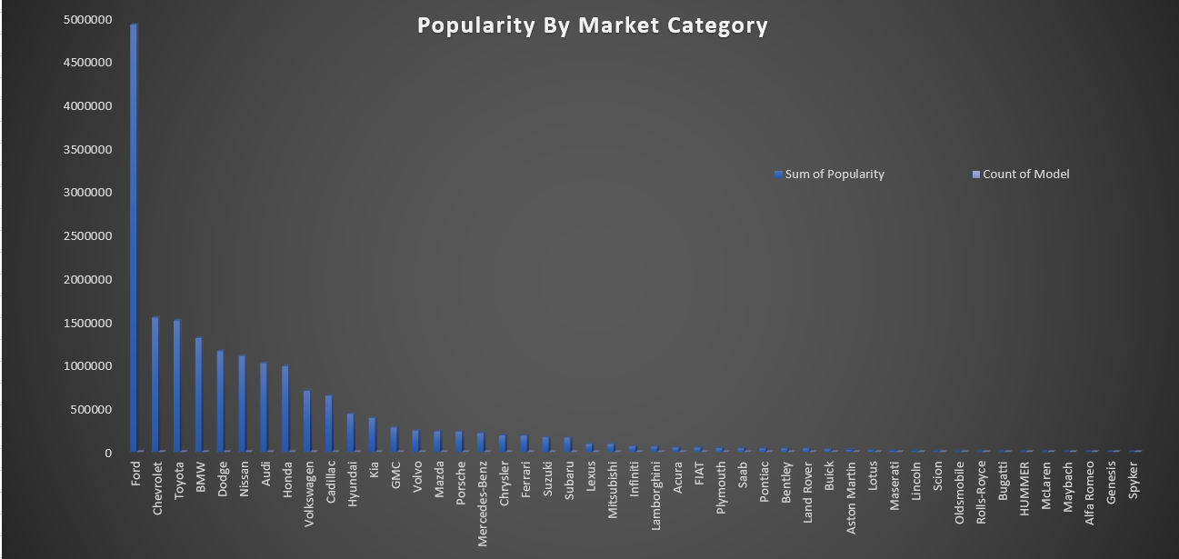
A_Task- 1: How does the popularity of a car model vary across
different market categories?

Slide 17
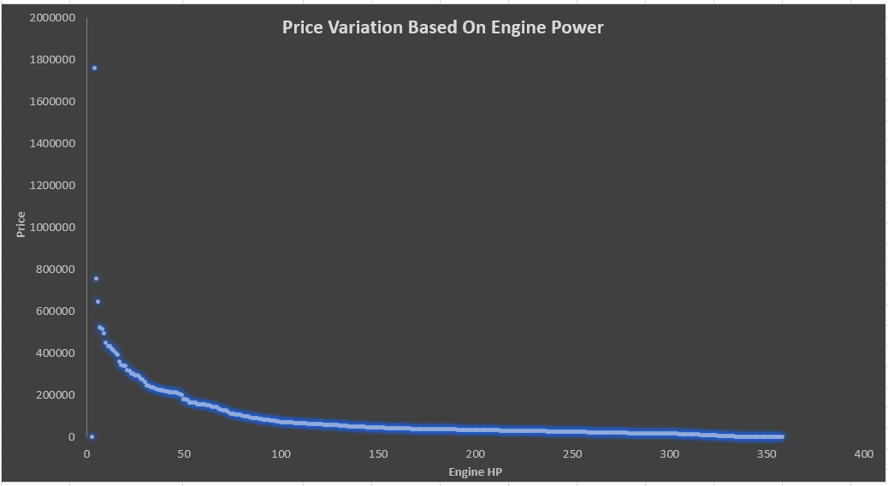
A_Task- 2: What is the relationship between a car's engine
power and its price?

Slide 18
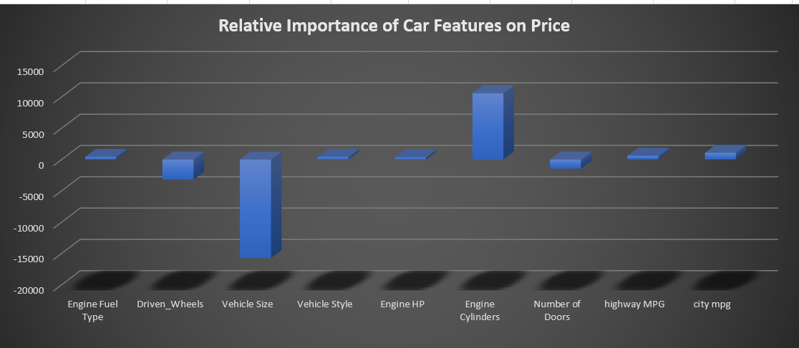
A_Task- 3: Which car features are most important in
determining a car's price?

Slide 19
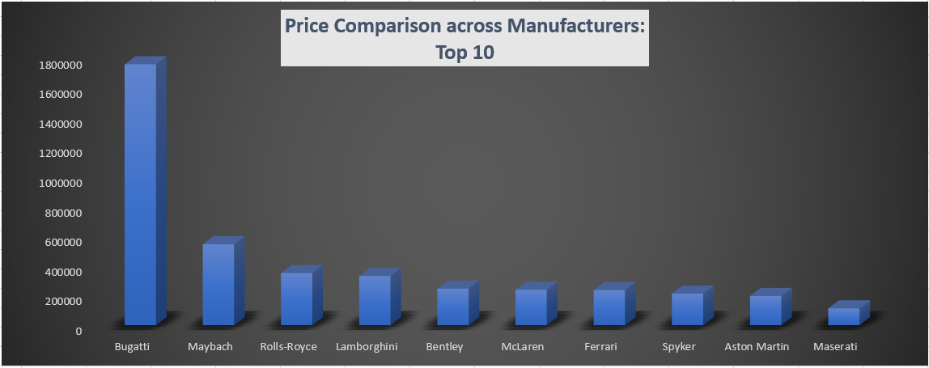
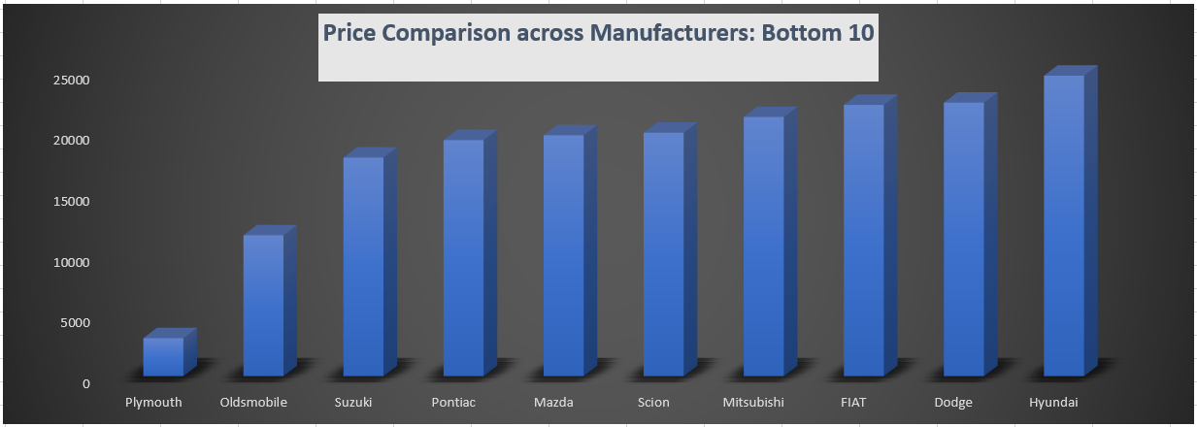
A_Task- 4: How does the average price of a car vary
across different manufacturers?

Slide 20
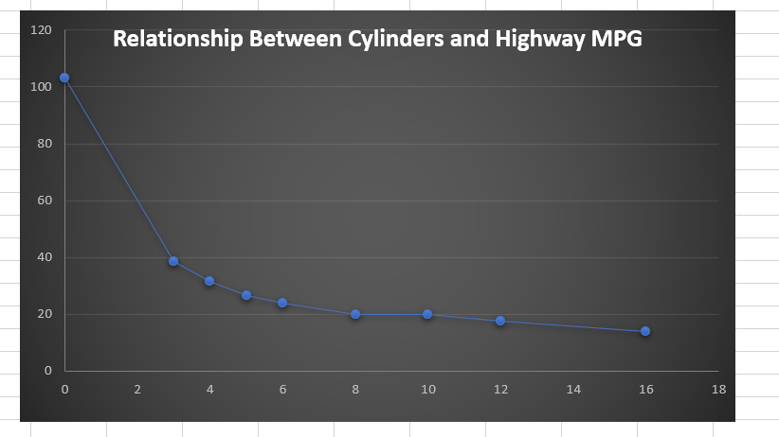
A_Task- 5: What is the relationship between fuel
efficiency and the number of cylinders in a car's engine?

Slide 21
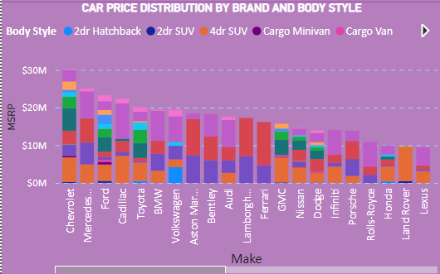
D_Task- 1: How does the distribution of car prices vary by
brand and body style?

Slide 22
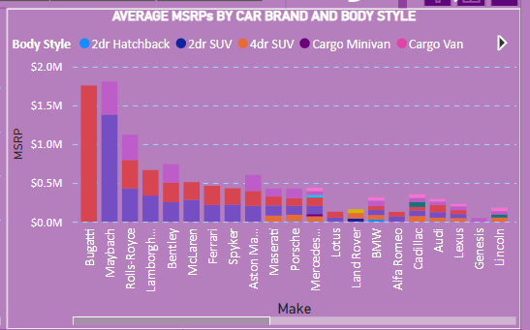
D_Task- 2: Which car brands have the highest and lowest
average MSRPs and how does this vary by body style?

Slide 23
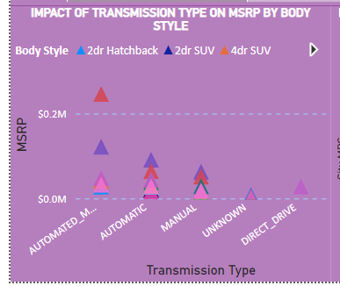
D_Task- 3: How do the different feature such as transmission
type affect the MSRP, and how does this vary by body style?

Slide 24
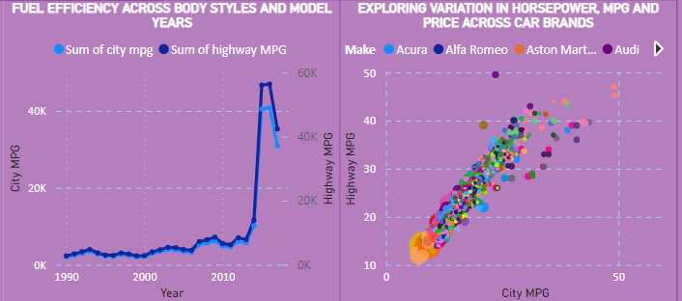
D_Task- 4: How does the fuel efficiency of cars vary
across different body styles and model years?

Slide 25
D_Task- 5: How does the car's horsepower, MPG, and
price vary across different Brands?

Slide 26
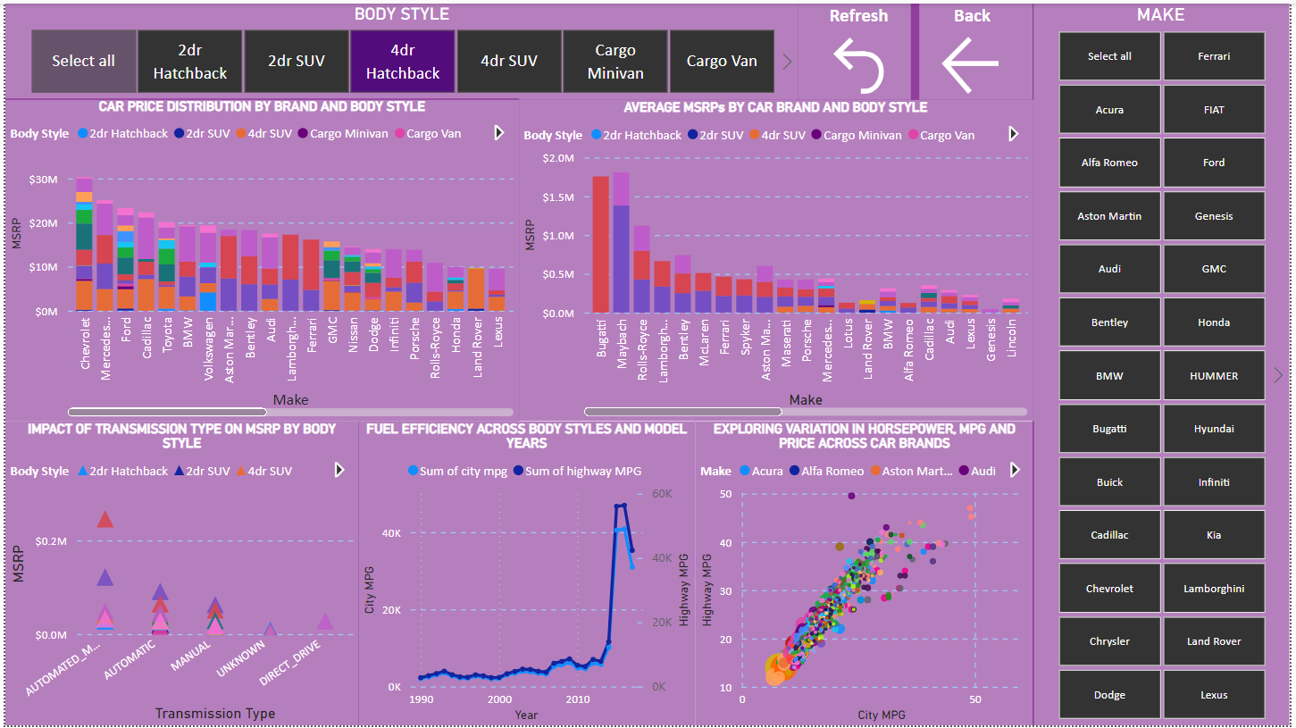
Dashboard

Slide 27
CONCLUSION
The analysis on the car's dataset revealed several important insights regarding car prices, market categories, car features, and fuel efficiency. The following key conclusions can be drawn from the findings:
• Car prices vary significantly by brand and body style. Some brands, such as Bugatti, Maybach, and Rolls Royce, have higher average MSRPs compared to others. The choice of body style also influences the price range of cars, with certain body styles commanding higher prices.
• Engine power, measured in horsepower (HP), plays a crucial role in determining car prices. Cars with higher horsepower tend to have higher average costs. This indicates that customers are willing to pay more for increased engine performance.
• The analysis highlights the relative importance of car features on price. Engine cylinder count, MPG (both city and highway), engine HP, vehicle style, and fuel type all contribute to the pricing of cars. Understanding these factors is vital for car manufacturers to set competitive prices and meet customer demands.
• The analysis also reveals differences in fuel efficiency across body styles and model years. While there have been improvements in overall fuel efficiency, variations exist among different body styles and over time. This information can guide car buyers in choosing more fuel-efficient options.

Slide 28
Drive Link
• Link for Excel file:
https://docs.google.com/spreadsheets/d/1IdiotrW17jLXa9XxueXP4DHyxxhJZWBf/edit?usp=sharing&ouid=111775799564275591184&rtpof=true&sd=true
• Link for Power BI Dashboard:
https://drive.google.com/file/d/1E0zOTAmqrgEH3wpb0lWoFGOe_hzVczaL/view?usp=sharing
• Link for video Presentation:
https://www.loom.com/share/bd3795de9cd848748e7d64d93a4f50ab?sid=9a912698-61f8-44bb-9592-3614ab1f9375

Slide 29


